Slide 1
Text Adventure Game
Nicholas BeharrySIngh
Edison Ng
Ahn Nam Nguyen
Aanish Mufti

Slide 2

STORYLINE
You are brought into a dungeon by an evil mage named Bakura. He lures you in order to train you in a form of forbidden magic to eventually aid him in conquering the world. Bakura’s rival Sickama awaits for you at the dungeon’s entrance to inform you of Bakura’s evil plan. In addition, Sickama introduces you to the magic which Bakura uses.

Slide 3

The dungeon itself is full of many undead, magical creatures treated as mob fights for the player to gain experience in magical combat. After each battle, we gain experience and new spells. In addition, the rooms have clues and other important tools needed to progress through the dungeon. Sickama will be your guide throughout the dungeon and it is up to you to learn the dark arts of his magic to put an end to his plan.

Slide 4

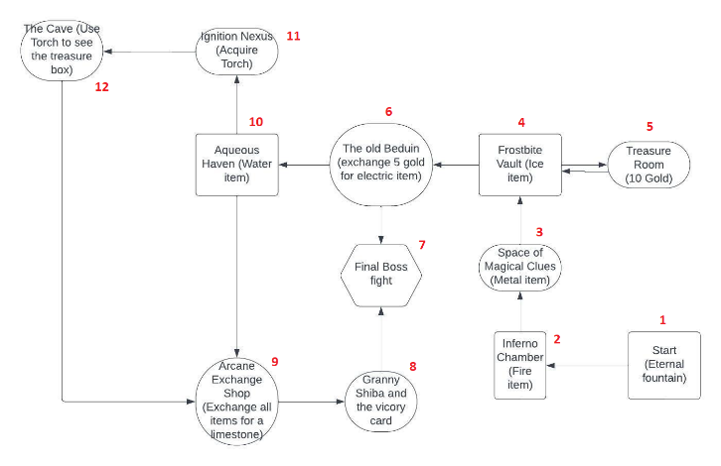
FLOORPLAN

Slide 5
CREATIONAL PATTERNS
Factory Method
Singleton method
Our enemy class is designed as a template such that all enemies in our game are created based off of that template. Each individual enemy utilizes identical methods, with different values.
The character class was created with the Singleton method in mind, as it was intended that only one character could exist at any given moment.

Slide 6
STRUCTURAL PATTERNS
Private Data class
Both the enemy class and the character class hide their data from the other classes and allow access only through getter and setter methods. All of the data that we utilize is stored in the private classes after initialization through data from our json files

Slide 7
BEHAVIOURAL PATTERNS
Command Methods
The game engine takes the player input command verb and uses it to tell the other classes what actions to take, such as the ‘inventory’ command given to the game engine class prompting the character class to show inventory through the ‘show_inventory’ method.

Slide 8

ANTIPATTERN

Slide 9
GOLDEN HAMMER
Accidentally made all enemies similar
All items in game were represented by text values which made it easy to make this mistake
A tool should not be represented the same as a weapon!!!!!!!!!!!!!!!!!!

Slide 10
FIX = POLYMORPHISM
Instead of having all items in a room in a list of strings, we had all items as JSON objects.
Each object has the details of the item and can be called with helper functions in order to alter this accordingly.

Slide 11

CUT AND PASTE PROGRAMMING
It was easy to replicate the user input for several applications of the program (combat/moving/collecting an item/inspecting the room)

Slide 12
FIX = APPROPRIATE METHODS + UNIQUENESS
Creating appropriate methods for each class to better take advantage of using the data from each item.
We moved away from each class having something too similar to each other which was the main issue which led to the cut and paste programming mistakes.

Slide 13
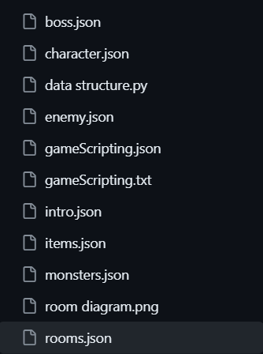
SEPARATION GAME CODE AND DATA:
Using JSON for storing scripting variables can be efficient in terms of readability and maintainability, especially for a large number of variables.
Minimize game variable: migrating most game variable to JSON for better management.
Ease of Modification: Using JSON makes it easier to modify scripting variables without modifying the Python code. This can be beneficial for quick changes or for allowing non-programmers to modify the game's behavior.
Expandability: Non programming person can handle game scripting without intercept game code

Slide 14
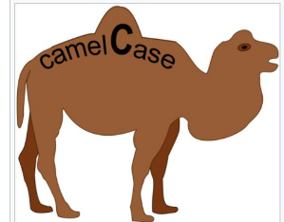
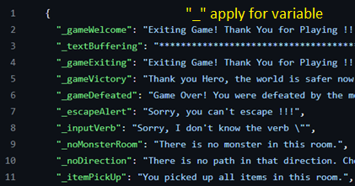
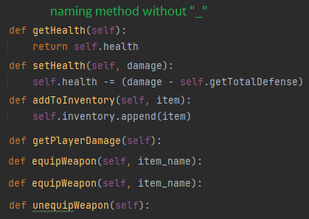
CAMELCASE RULES FOR NAMING GAME VARIABLES AND METHODS:
There are several advantages to applying camelCase rules for naming variables:
Readability: CamelCase makes variable names easier to read by visually separating words within the name.
Consistency: Following a consistent naming convention across your codebase improves readability and maintainability.
Conciseness: CamelCase allows you to create descriptive variable names without the need for underscores, leading to more concise code.
Clarity: CamelCase helps to make the purpose of a variable more clear by capitalizing the beginnings of words.
Compatibility: CamelCase is a widely used convention in many programming languages, making your code more familiar to other developers.

Slide 15
THANK YOU !!!
Github:
https://github.com/nganhnam2510/TMU_CCPS406_Winter2024_Nam

